Slide 1
Mended Hearts
An Evening with your Pharmacists

Slide 2
Mike Boyd, Pharm D
Specialty Practice Pharmacist
Electrophysiology

Slide 3
Antiarrhythmic drugs

Slide 4
Antiarrhythmic drugs
Name (Brand Name)
Quinidine (Quinaglute®, Quinidex®)
Disopyramide (Norpace®)
Mexiletine (Mexitil®)
Flecainide (Tambocor®)
Propafenone (Rythmol®, Rythmol SR®)
Amiodarone (Cordarone®, Pacerone®)
Dofetilide (Tikosyn®)
Dronedarone (Multaq®)
Sotalol (Betapace®, Betapace AF®)

Slide 5
Kevin Kissling, Pharm D
Specialty Practice Pharmacist
Cardiology/Cardio-thoracic Surgery

Slide 6
Anticoagulants
Commonly referred to as “blood thinners”
Used for 2 primary reasons:
Prevent a new clot from forming
Atrial Fibrillation
Other high risk states
Treat an existing clot
Pulmonary Embolism (PE)
Deep Vein Thrombosis (DVT)

Slide 7
Warfarin (Coumadin®)
Drug of choice for more than 50 years
Requires monitoring of PT/INR
Reflects level of anticoagulation
Allows for daily dose to be adjusted
Effect can be reversed with Vitamin K
Diet can effect control
Key is consistency, not avoidance

Slide 8
The New Anticoagulants
Dabigatran (Pradaxa®)
Must be taken twice daily
Must be stored in original packaging
Rivaroxaban (Xarelto®)
Once daily dosing
Should be taken with the evening meal
Apixaban (Eliquis®)

Slide 9
Tips for All Anticoagulants
Take as directed
Alert healthcare workers you are taking
Have a plan for invasive procedures
Screen for drug interactions
Safety in emergent situations
Be mindful of signs of bleeding
Blood in urine, stool
Seek medical attention for persistent bleeding

Slide 10
Danielle Blais, Pharm D
Specialty Practice Pharmacist
Acute Coronary Syndromes

Slide 11
Coronary Artery disease
Leading cause of death in both men and women
Risk factors
Age
Smoking
Diabetes
High blood pressure
High cholesterol

Slide 12
Coronary Artery Disease

Slide 13
Protect your Stent
To keep your Stent open
Aspirin 81 mg daily
FOR LIFE
Clopidogrel (Plavix) 75 mg daily
Depends on the type of stent
Side effects- bleeding
Take your medication daily
Do not stop taking unless directed by your Cardiologist

Slide 14
Pamela burcham, Pharm D
Specialty Practice Pharmacist
Cardiology/Cardio-thoracic Surgery

Slide 15
High Cholesterol
Makes you at risk for a heart attack
Good cholesterol – HDL
Bad cholesterol – LDL
Statins :
Atorvastatin (Lipitor)
Lovastatin (Mevacor)
Simvastatin (Zocor)
Rosuvastatin (Crestor)
Pravastatin (Pravachol)

Slide 16
What to watch out for
Side effects:
Muscle pains
Stomach bloating
Drug interactions :
Amiodarone
Blood thinners
Seizure medications
Antidepressants

Slide 17
Kerry pickworth, Pharm D
Specialty Practice Pharmacist
Heart Failure

Slide 18
Heart failure

Slide 19
Drugs used to treat
Drugs which make the heart pump more effectively
Enalapril, Lisinopril, Valsartan (Diovan), Losartan (Cozaar)
Metoprolol XL (Toprol XL), Carvedilol (Coreg)
Drugs which improve the symptoms
Diuretics ( water pills )
Furosemide (Lasix) , Torsemide (Demadex)

Slide 20
Water Pills
Weigh yourself daily
If weight ↑ by 2-3 lbs /day or 5 lbs /wk
Watch you liquid intake
Restrict your salt intake
May need potassium and magnesium supplements

Slide 21
Sajni patel, Pharm D
Cardiology Pharmacy Resident

Slide 22
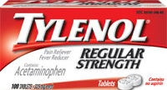
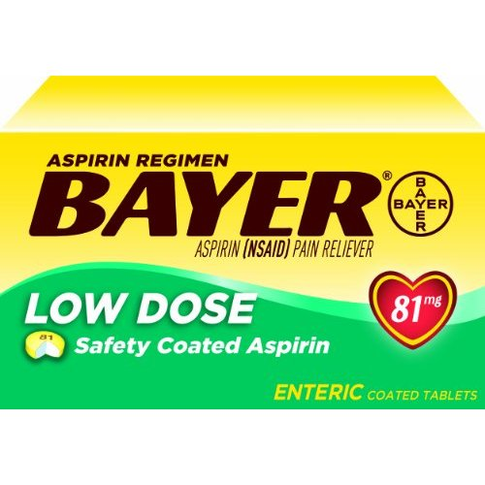
Aches, Pains, and Fevers
Acetaminophen (Tylenol)
Dose
325-650 mg every 4-6 hours
Maximum of 4,000 mg per day
Aspirin
Dose
325-650 mg every 4-6 hours
Side Effects
Bleeding
Upset stomach

Slide 23
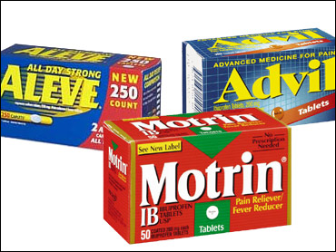
Do Not Use
Non-Steroidal Anti-inflammatory Drugs (NSAIDs)
Ibuprofen (Motrin, Advil)
Naproxen (Aleve)

Slide 24
Avoid NSAIDs
Why?
Damages the kidneys
Increased risk of heart attack and stroke
Can increase blood pressure
Can interact with many medications, including:
Warfarin (Coumadin)
Aspirin
Clopidogrel (Plavix)

Slide 25
Kristen Tasca, Pharm D
Cardiology Pharmacy Resident

Slide 26
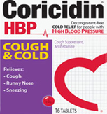
Cough and Cold
Chlorpheniramine (Coricidin HBP)
Variety of available formulations
Guaifenesin (Robitussin)
Variety of available formulations

Slide 27
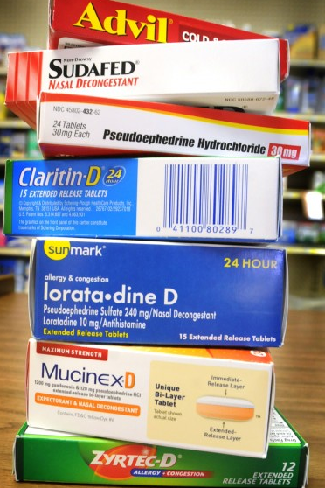
Do not Use
Pseudoephedrine Products
Sudafed
Advil Cold and Sinus
DayQuil-D
NyQuil-D
Claritin-D
Mucinex-D
Phenylephrine
Sudafed PE
DayQuil
Nyquil Sinus

Slide 28
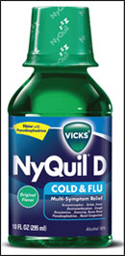
Check the Labels

Slide 29
Erik abel, Pharm D
Specialty Practice Pharmacist
Cardio-thoracic Surgery

Slide 30
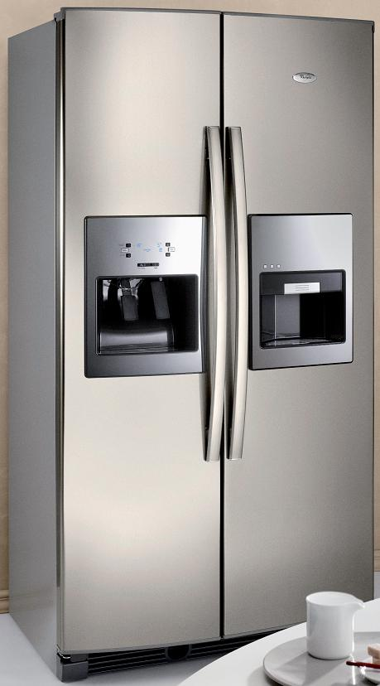
How can I Help myself?
Be your own best advocate
Allergies?
Stopped meds ...Why?
New medication?
Risks?
Interactions?
Adherence?
Cost?
Be compliant for the best outcome
Time

Slide 31
How can I Help myself
Coordinate your care
Talk to all your healthcare providers
Planning for procedures?
Refills?
Ask questions
Primary Care Physician, Cardiologist
Pharmacist
Dentist

