Slide 1
Cardiac Rehab: Improving Outcomes One Step at a Time
Martha Gulati MD, MS, FACC, FAHA
Associate Professor of Medicine (Cardiology)
Associate Professor of Clinical Public Health (Epidemiology)
Sarah Ross Soter Chair in Women’s Cardiovascular Health
Director for Women’s Cardiovascular Health and Preventive Cardiology
The Ohio State University, Columbus, OH

Slide 2
Exercise for 2° CHD Prevention: Who?
Eligibility for Cardiac Rehabilitation
Post MI, ACS
Post CABG
Post PCI
Post Valve Repair/Replacement
Stable Angina
Heart Transplant
Medicare was considering Advanced Heart Failure but to date, no coverage

Slide 3
Exercise for 2° CHD Prevention: Why?
Proven Benefit
Reduction in All-Cause Mortality by 20-32%
Reduction in Sudden Cardiac Death by 37%
Reduction in Fatal Recurrent MI by 22%
19% Reduction in Mortality in those attending 2/3 of sessions
Lavie et al Mayo Clinic Proc 2009;84: 373-83

Slide 4
Exercise for 2° CHD Prevention: Why?
Proven Risk Factor Modification
Risk Factor Reduction:
Total Cholesterol (-14.3 mg/dL CI -23.4 – -4.2)
Systolic Blood Pressure (-3.2 mm Hg: -5.4 – -0.9)
Increased Smoking Cessation
40-70% reduction in Depression, Anxiety and Hostility,
Regular Exercise, Healthier Diet
Taylor et al. AM J Med 2004; 110
Lavie et al Am J Cardiol;2004:93
Lavie et al. Mayo Clinic Proc 2006:80

Slide 5
Exercise for 2° CHD Prevention: Why?
Improved functional capacity
Improved CAD risk factor control
Reduced depression
Improved survival
Though originally designed for coronary artery disease patients, there is accumulating evidence that patients with other cardiac diseases will also benefit from cardiac rehabilitation

Slide 6
Women and Cardiac Rehabilitation
Paucity of research on Women and Cardiac Rehabilitation
In meta-analysis, 54% of studies included women, but women made up only 20% of all participants
Only 25% of women eligible for cardiac rehabilitation are referred to cardiac rehabilitation
Of the 25% referred, only 50% enroll
Of those enrolled, only 15% complete a 12-week program (women and smokers less likely to complete)
African American Women less likely to be referred, attend and complete Cardiac Rehab than white women
Taylor et al. Am J Med 2004; 110
Benz-Scott et al. J Women Health 2002;11:773-91
Notes:
African American Women also more likely to have CV risk factors

Slide 7
Cardiac Rehabilitation 2011
Doesn’t everyone already go to cardiac rehabilitation?
Cardiac rehabilitation programs remain underused in the United States, with an estimated participation rate of only 10-20% of the >2 million eligible patients/year who experience an AMI or undergo coronary revascularization
Rates of 13 - 41% for men and 7 - 22% for women reported in various regional and national surveys
Highest rates post-CABG
Lowest rates after elective PCI
Ades PA. N Engl J Med. 2001; 345: 892–902

Slide 8
Cardiac rehabilitation can significantly improve the life expectancy and quality of life of people who have had a recent cardiac event, such as a heart attack, angioplasty or heart surgery.

Slide 9
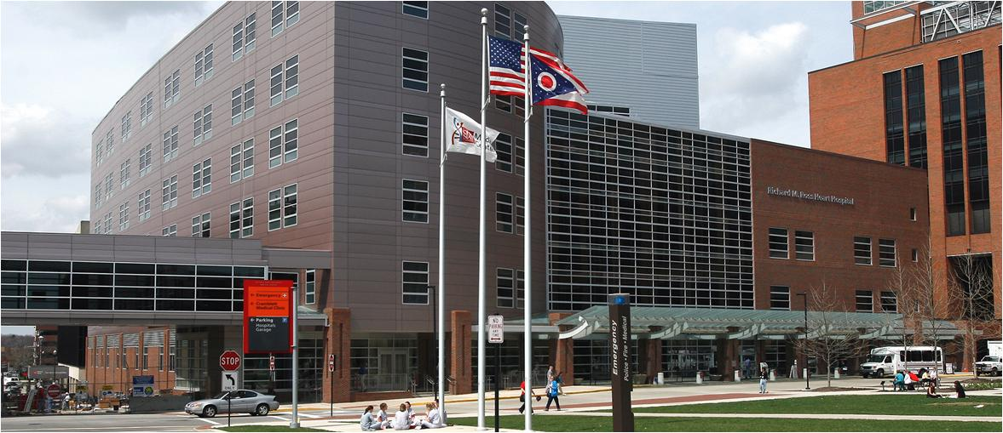
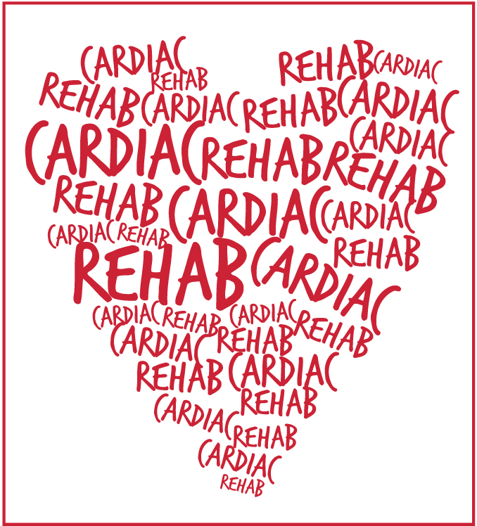
Notes:
9

Slide 10
Exercise considerations for the angina patient
Goal: increase anginal and ischemic threshold
Prolonged warm-up & cool down (gradual rise)
Target HR below ischmic level (± 10 bpm)
Caution with exertion in the cold
Upper body exercise may precipitate symptoms due to higher pressor response
NTG
Monitor blood pressures before and after exercise (or NTG use)
Alternative exercise: frequent, short, intermittent sessions

Slide 11
Exercise considerations for the CHF patient
Must be on stable medical therapy
Monitor hypokalemia and hemodynamic response
Malignant dysrhythmia
THR 40-70% VO2max 3-7days per week, 20-40 minutes per session
Long warm-up and cool down
Interval exercise training
RPE may be used

Slide 12
Exercise considerations for the cardiac transplant patient
1-3 year survival rates of 86% and 80%
Train wreck physically and metabolically
Rx from data from testing, graded protocols
Long warm up & cool down
Denervated heart = no angina, low EKG sensitivity for ischemia, delayed cardioacceleratory (and deceleratory) response
Stress echo or radionuclide testing
Intensity:
50-75% of VO2peak
RPE of 11-15 on the 6-20 scale
Dyspnea

Slide 13
Exercise considerations for the pacemaker/ICD patient
Fixed vs. adjustable rate
Monitor systolic pressures
Extended warm-up and cool down
ICD: ECG monitoring/pulse to titrate intensity
Rate modulated pacemakers intensity:
MHRR method of Karvonen
Fixed percentage of MHR
RPE
METs

